Slide 1

Department of ME
23ME1103
Audio and video content in HTML
Session-4
A COMPLETE SOLUTION TO
DESIGN TOOLS WORKSHOP
K L U Students
1st year
For
EXIT

Slide 2



AIM OF THE SESSION
To familiarize students with the Audio and video content in HTML
INSTRUCTIONAL OBJECTIVES
This Session is designed to: Obtain knowledge of Audio and video content in HTML
LEARNING OUTCOMES
At the end of this session, you should be able to: Understand the Audio and video content in HTML

Slide 3
SESSION INTRODUCTION
Programmable logic falls into two different types:
1. Understanding of adding Audio in HTML
2. Understanding of adding video in HTML

Slide 4

Session Plan: 4
SESSION DESCRIPTION
Summary of Last Session- 5 min
Topic –Adding audio and video content in HTML5 -20min
Split to sections- 5min
Experimentation using tool -40 min
Assessment and Interaction (Active Learning Method) – 10 min
Documenting Results Summary and result Explanation- 20 min
Submitting as Assignment in LMS

Slide 5
HTML5 Audio Tag:
The HTML <audio> element is used to embed sound content in documents. It may contain one or more audio sources, represented using the src attribute or the <source> element: the browser will choose the most suitable one.
HTML5 most commonly used audio formats are ogg, mp3 and wav. You can use <source> tag to specify media along with media type and many other attributes.
An audio element allows multiple source elements and browser will use the first recognized format.

Slide 6
HTML5 Video Tag:
HTML5 <video> element provides a standard way to embed video in web pages. However, the video element is relatively new, but it works in most of the modern web browsers.
The simply inserts a video into the HTML5 document, using the browser default set of controls, with one source.

Slide 7
Audio Attributes:
Attribute | Value | Description
controls | *Boolean attribute | You need this to make the native audio player appear. Otherwise, you would have to use DOM to control the audio element to play your music.
autoplay | *Boolean attribute | If this guy exists, the browser will just play your song or your speech without asking permission from your visitor.
loop | *Boolean attribute | Keep repeating your music
src | url | The URL of your audio file
preload | none | metadata | auto | This attribute was formerly known as "autobuffer" and it was an boolean attribute as "controls". none - do not buffer audio file automatically. metadata - only buffer the metadata of audio file. auto - buffer audio file before it gets played.

Slide 8
Video Attributes:
Attribute | Value | Description
controls | *Boolean attribute | If you want the browser native player control to be around, specifiy "controls"
autoplay | *Boolean attribute | If this guy exists, the browser will just play your video without asking permission from visitor
loop | *Boolean attribute | Keep repeating your video
src | url | The URL of your video file
preload | none | metadata | auto | This attribute was formerly known as "autobuffer" and it was an boolean attribute as "controls". none - do not buffer video file automatically. metadata - only buffer the metadata of video auto - buffer video file before it gets played.
width | width in pixels | Width of video player
height | height in pixels | Height of video player
poster | url of a image file | If present, shows the poster image until the first frame of video has downloaded.

Slide 9
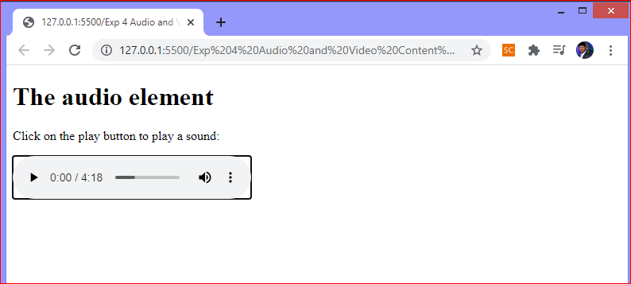
HTML5 Audio Tag:
<audio controls>
<source src=" Deep_Meditation.ogg" type="audio/ogg">
<source src=" Deep_Meditation.mp3" type="audio/mpeg">
Your browser does not support the audio element.
</audio>

Slide 10
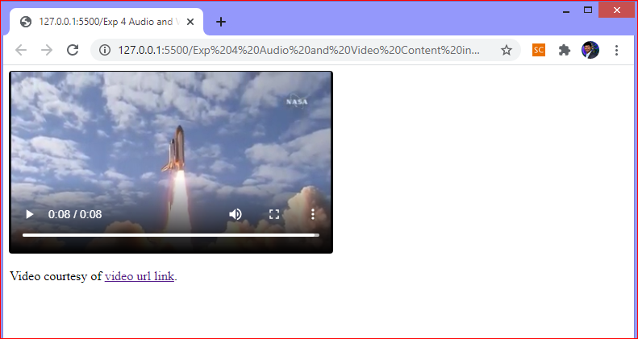
HTML5 Video Tag:
<video width="320" height="240" controls>
<source src="NASA.mp4" type="video/mp4">
<source src="NASA.ogg" type="video/ogg">
Your browser does not support the video tag.
</video>

Slide 11
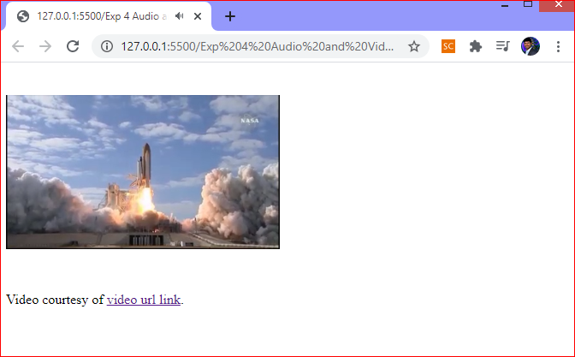
HTML <video> Auto play:
To start a video automatically use the autoplay attribute:
<video width="320" height="240" autoplay>
<source src="NASA.mp4" type="video/mp4">
<source src="NASA.ogg" type="video/ogg">
Your browser does not support the video tag.
</video>

Slide 12
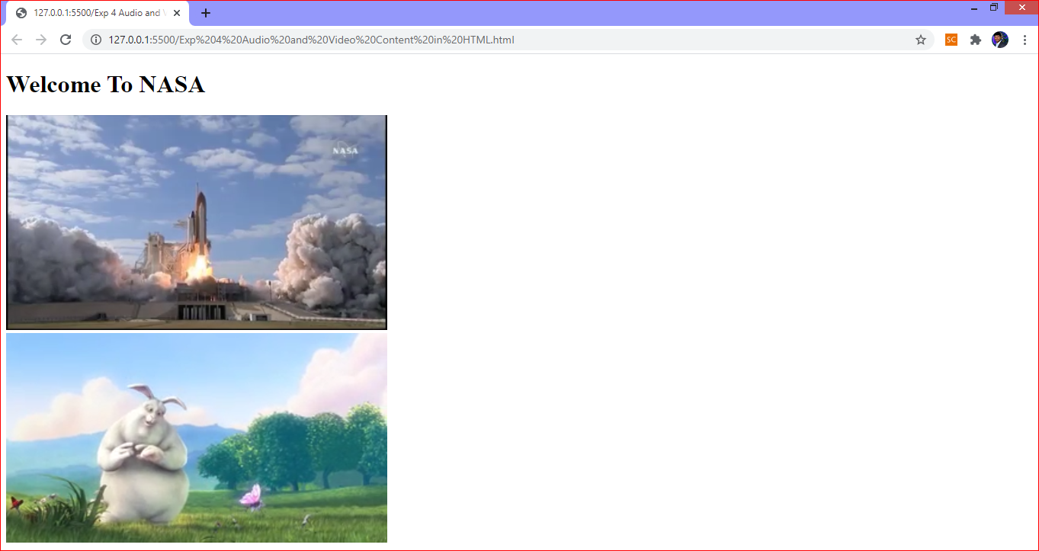
Two videos playing in same window:

Slide 13
SUMMARY
Understanding about the addition of Audio and Video in HTML

Slide 14
SELF-ASSESSMENT QUESTIONS
Mention the tag for addition of Audio in HTML
Mention the tag for addition of Video in HTML

Slide 15
TERMINAL QUESTIONS
Enlist the commands for addition of Audio in HTML
2. Enlist the commands for addition of video in HTML

Slide 16
THANK YOU

